Slide 1
Superstore Sales & Profit Analysis Personal Project
Pappula Madhusudhan Reddy

Slide 2
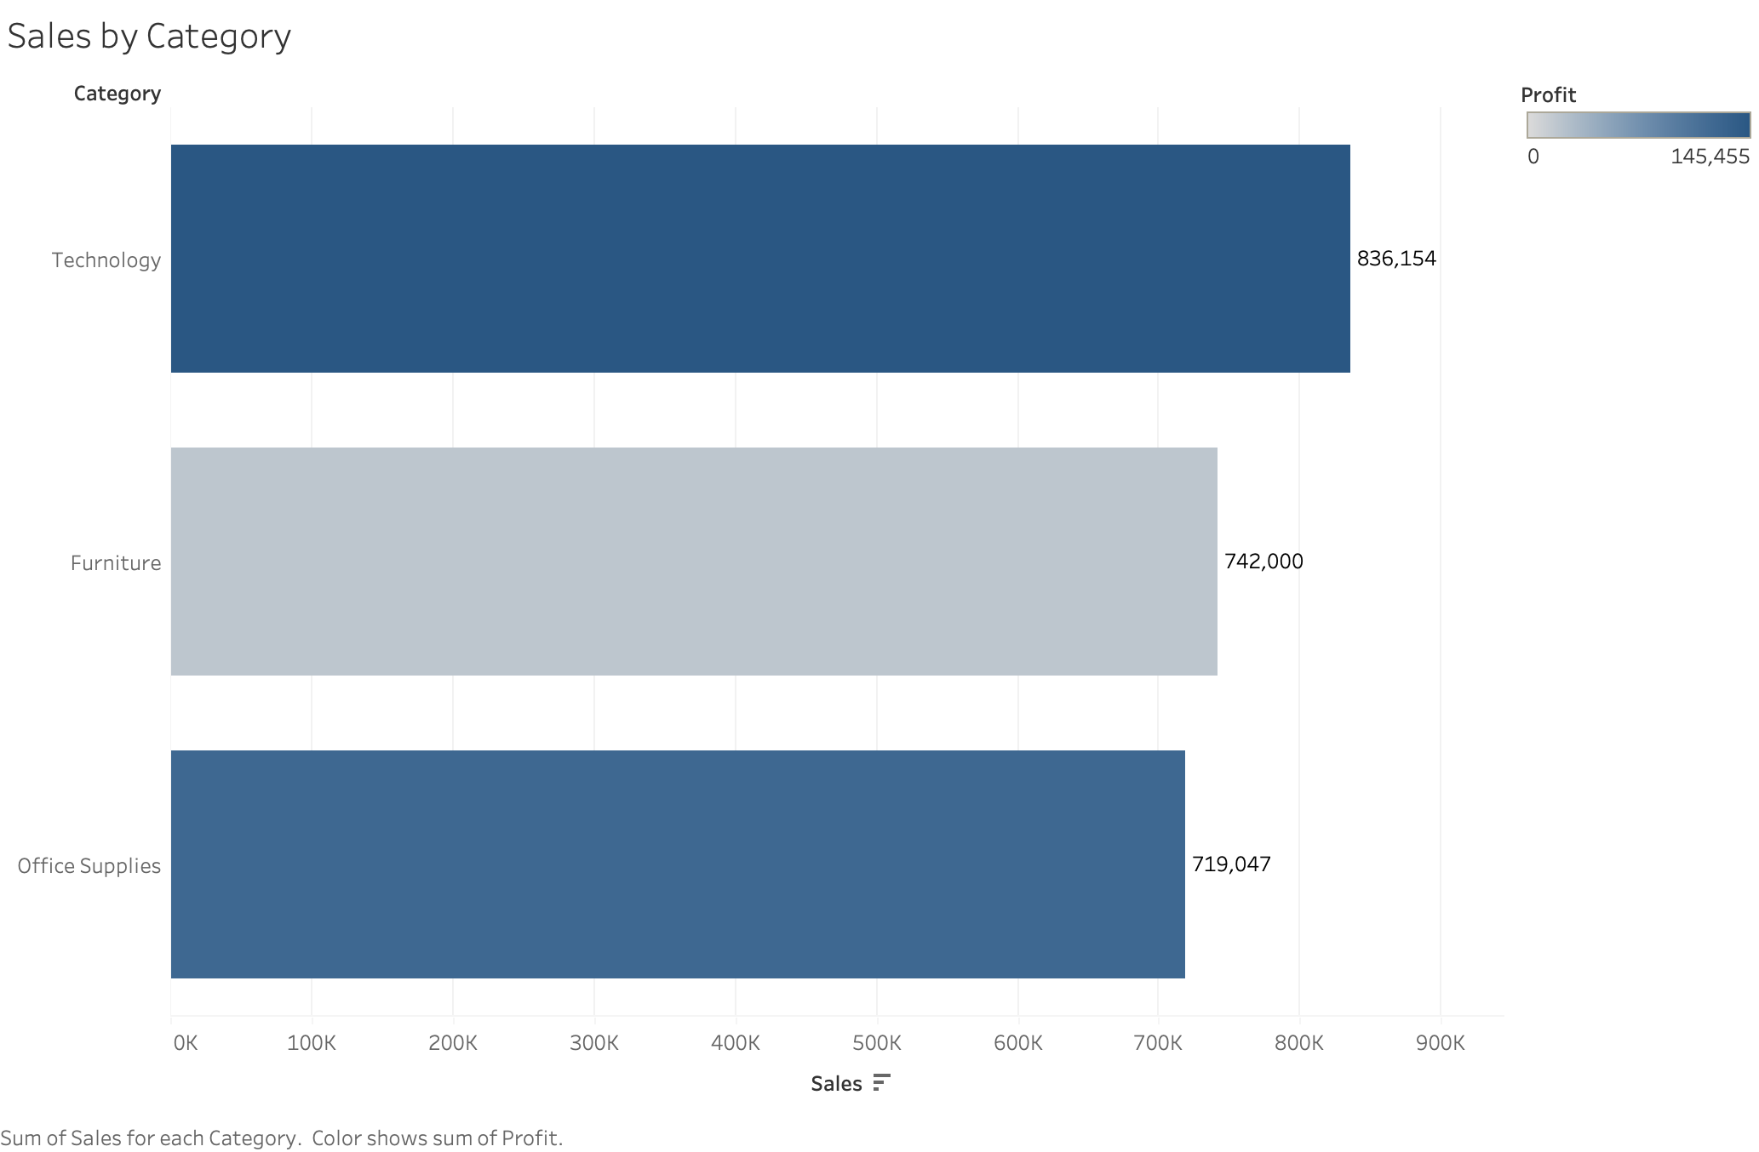

Slide 3
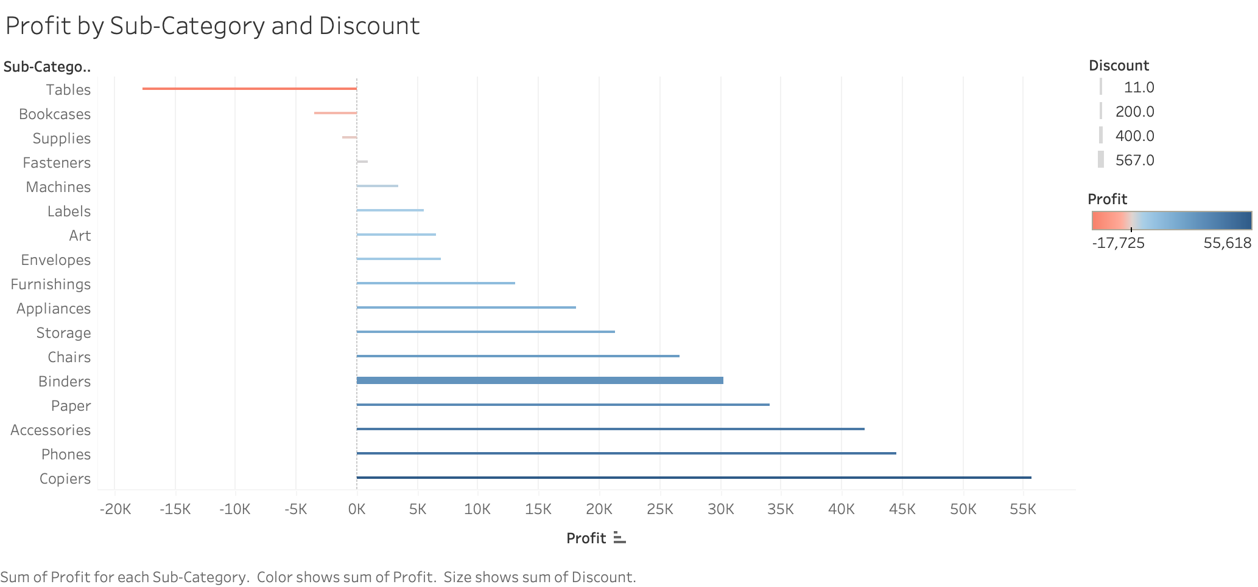

Slide 4


Slide 5
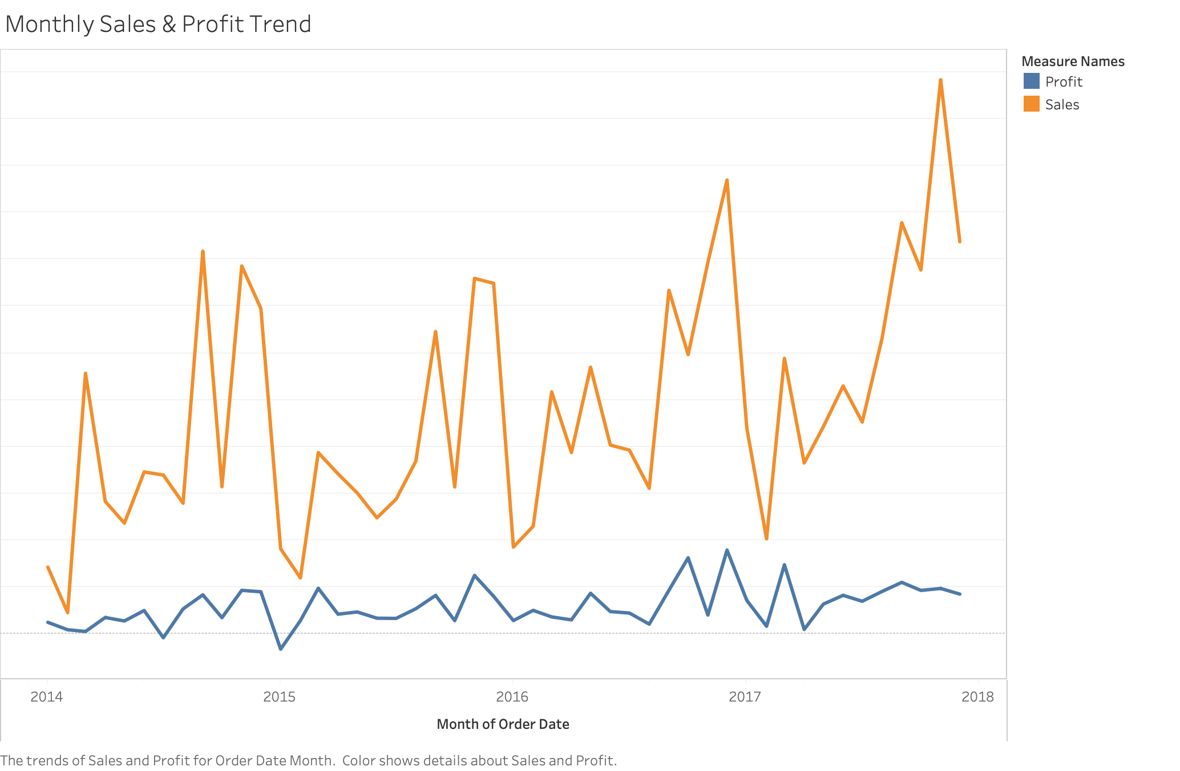

Slide 6
